Slide 1
Bobobox Assignment
Adam Aditama
Data Engineer

Slide 2
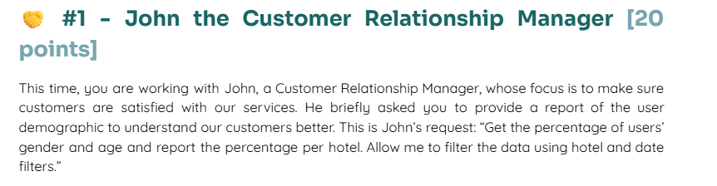
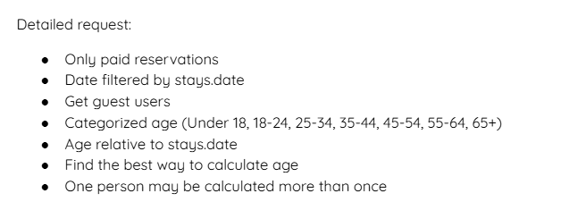
Question

Slide 3
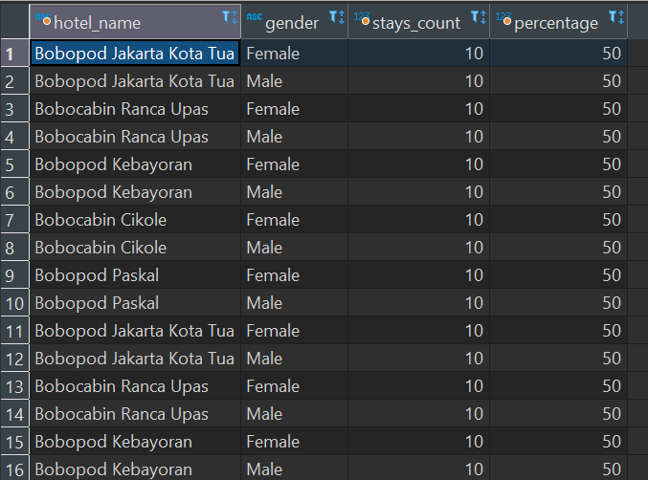
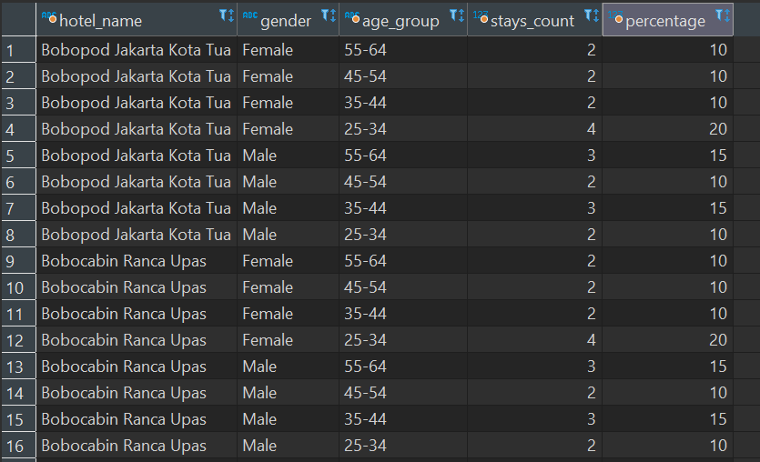
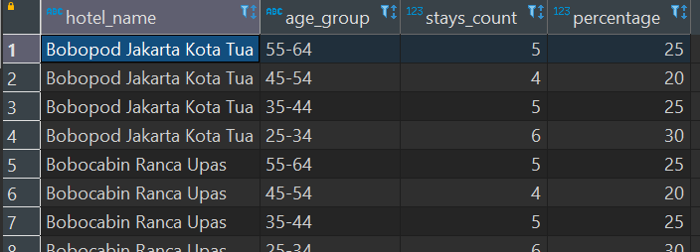
Answer
2. Based on gender
All Data
3. Based On Age Group
Click Here For Detail Query

Slide 4

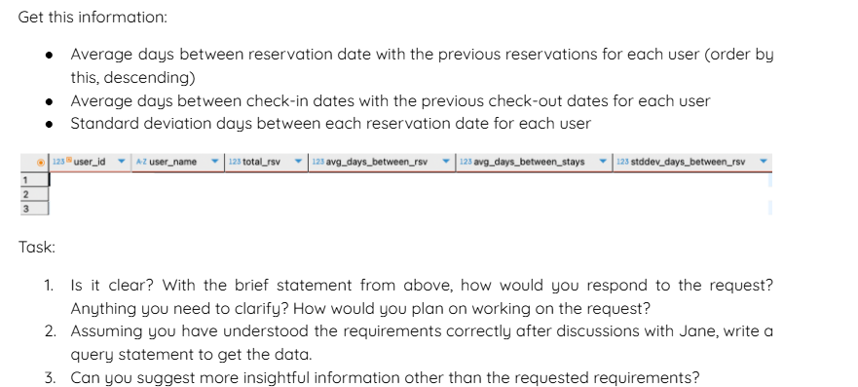
Question

Slide 5
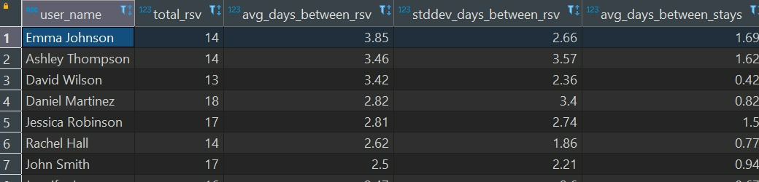
Answer
From Jane request, i want to ask about:
Should we only consider reservations with status 'Paid' in the reservations table? Since only 'Paid' status represents actual completed reservations, what if he/she canceled after paid, is it still count or not?
Should all users be included in the analysis, or only those with more than one reservation/stay?
Result:
Click Here For Detail Query

Slide 6
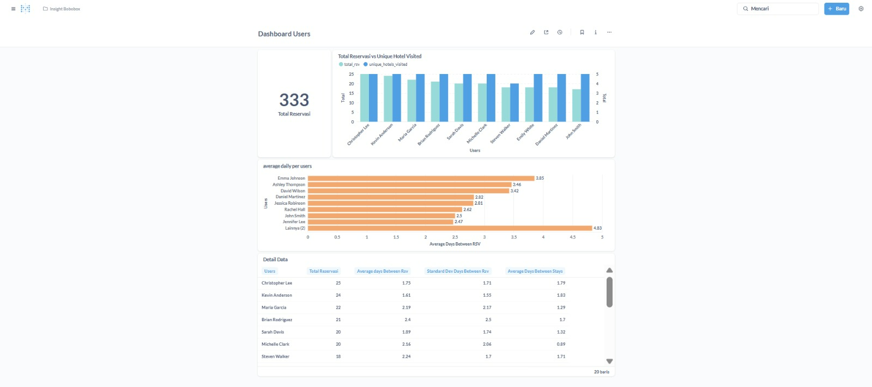
Answer
I add Total Reservations VS Total Unique Hotel Visited for extra insight

Slide 7
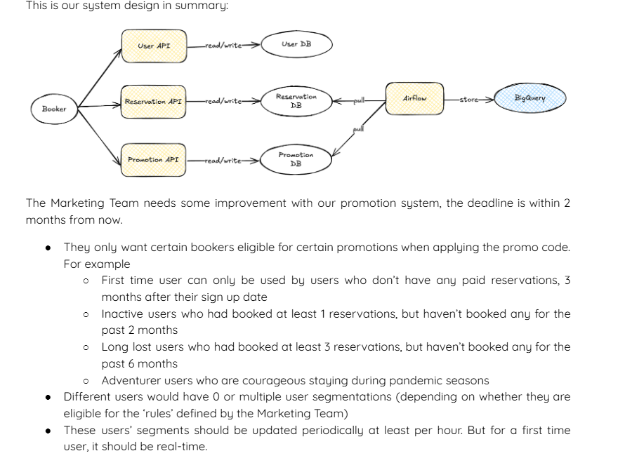
Question

Slide 8
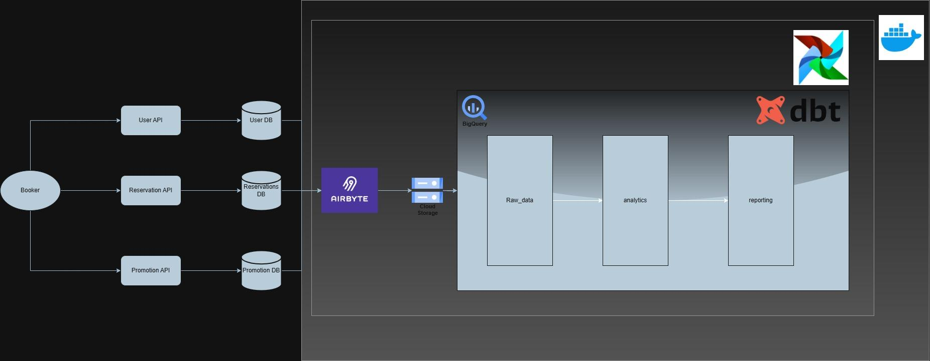
Answer
Source Systems: Booker sends data via APIs (User, Reservation, Promotion), which each store data in their respective databases.
Data Ingestion via Airbyte: Airbyte extracts data from these databases and writes it to Cloud Storage.
Data Modeling & Reporting: Data flows from Cloud Storage into BigQuery and is modeled using dbt through layers: raw_data → analytics → reporting. Orchestration is handled by Airflow, all within Dockerized environments.

Slide 9
Answer
✅ Pros
Simplified Pipeline: Uses a single tool (Airbyte) to manage data extraction from all sources.
Familiar Stack: BigQuery and dbt are tools already known by the team, speeding up adoption.
Modular Architecture: Clear separation between ingestion, storage, transformation, and reporting.
❌ Cons
Limited Real-Time Capability: Since the flow is batch-based, it’s not ideal for use cases needing real-time data.
Operational Overhead: Requires managing multiple components (Airbyte, Cloud Storage, Airflow, dbt) which can add maintenance complexity.
Data Quality Risk: Without proper monitoring or validation, inconsistent source data might propagate through all layers.

Slide 10
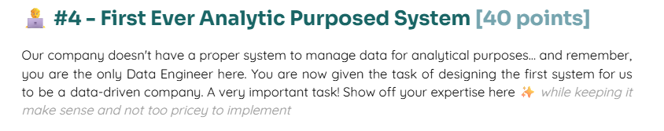
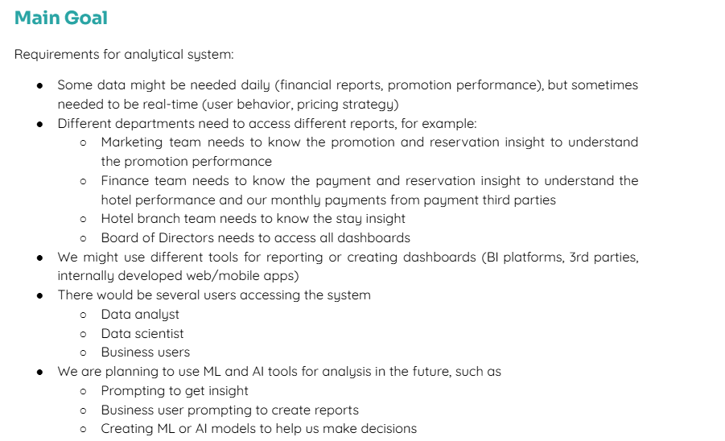
Question

Slide 11
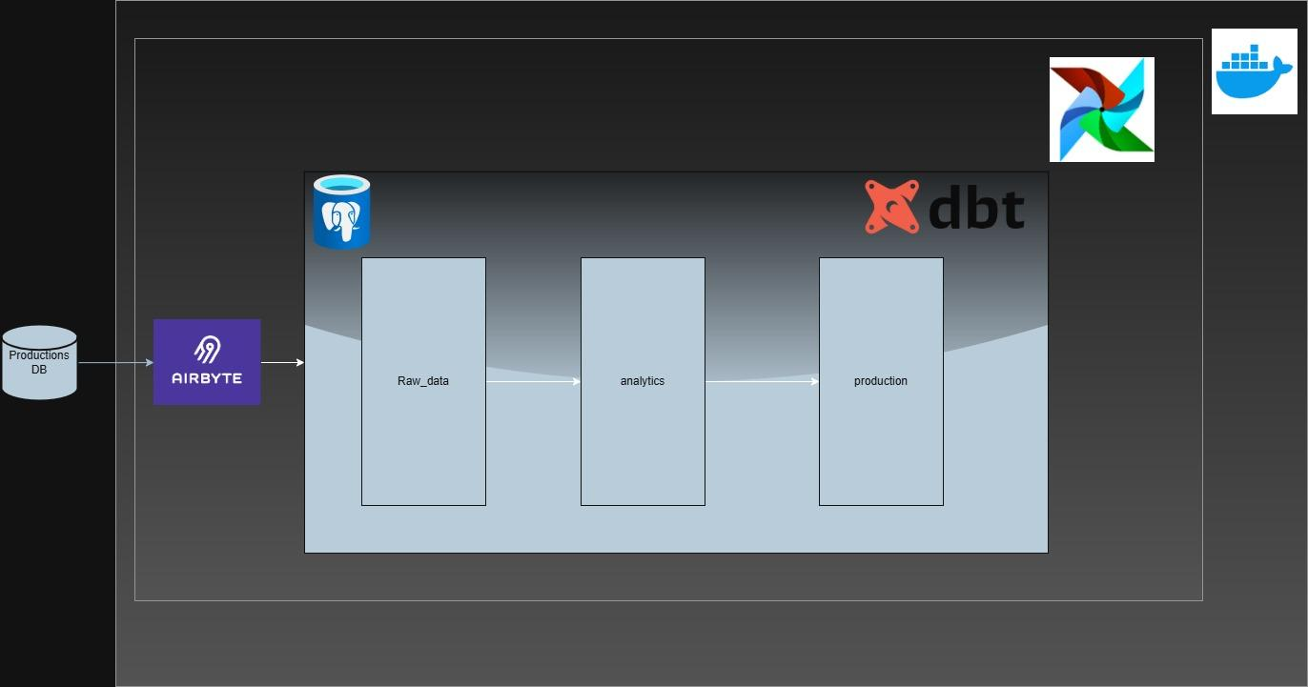
Answer
Here’s my flow, so i still use airflow combine airbyte and Dbt. Why i still use Airflow while on Airbyte you can set schedule? Because we dont know someday not only DB that we need to extract, maybe API, Scrapping and etc. So we use airflow to trigger airbyte and if we need another ETL without airbyte we still can combine it with airflow.

Slide 12
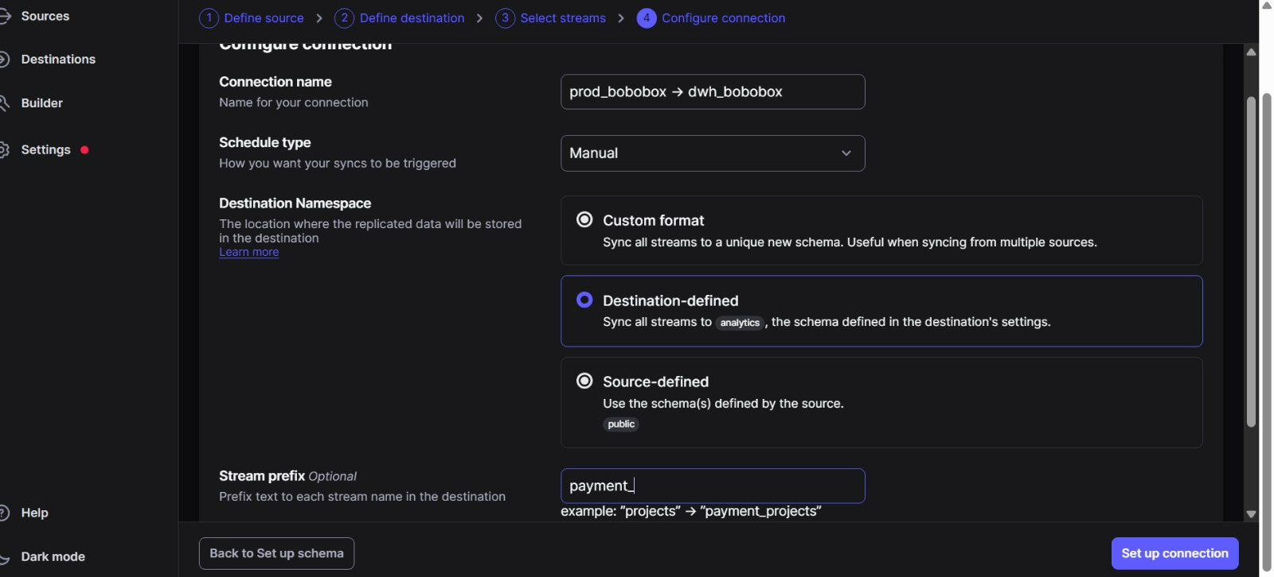
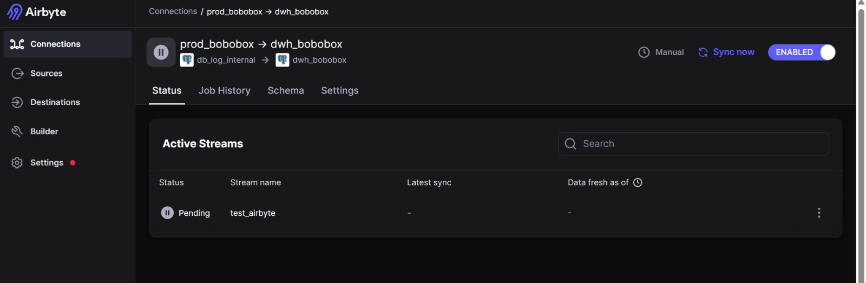
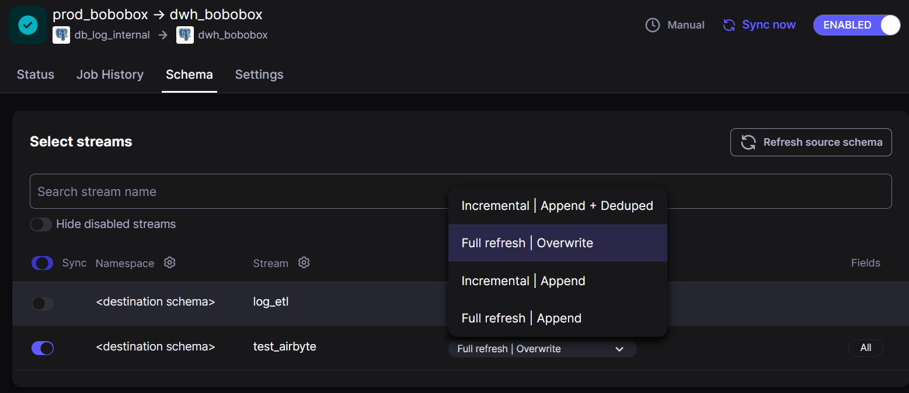
Why Airbyte?
Pre-built Connectors Airbyte supports hundreds of ready-to-use connectors for popular databases, APIs, and SaaS platforms. This reduces the need for custom ETL scripts and allows quick integration with the production DB.
Incremental & Full Sync Capabilities Airbyte supports both full refresh and incremental loading. This improves efficiency by only syncing new or updated records, minimizing load on the source system.
Modular & Open Source Being open source, Airbyte can be self-hosted, customized, and integrated easily within containerized environments like Docker. This makes it flexible and cost-effective compared to proprietary tools.
Seamless Integration with Modern Stack Airbyte works well with PostgreSQL, BigQuery, Snowflake, and dbt—making it an ideal choice for modern ELT workflows. It focuses solely on EL, while dbt handles the T (transformation).

Slide 13
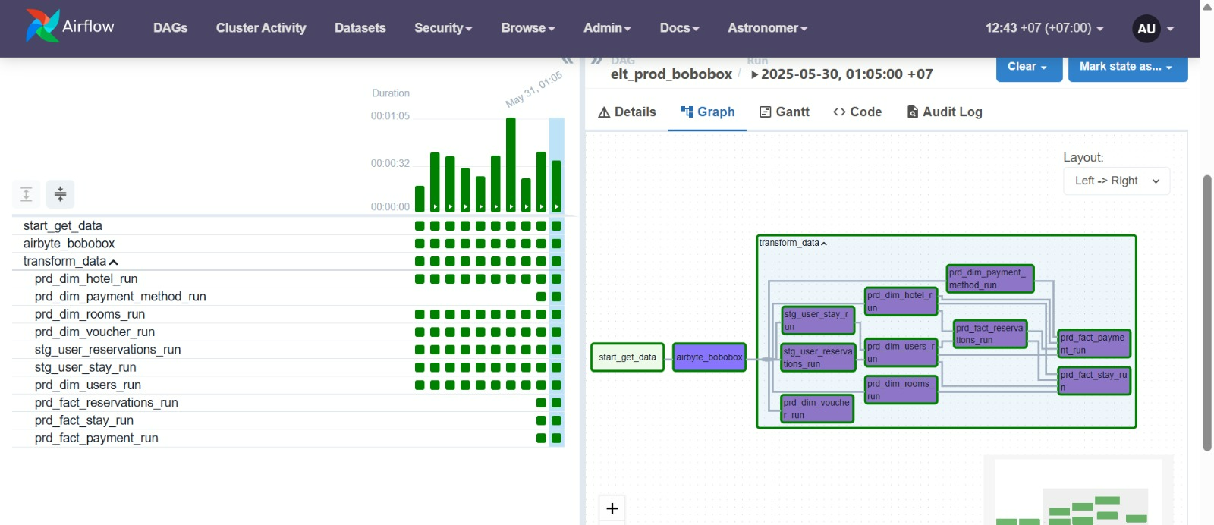
In our case, i try to build our analytical system. So i try to split per schema, which are:
raw_data: unprocessed extracted data (In case we get data from API or anything without using airbyte)
analytics: cleaned and modeled data for analysis (Updated data from production db or from raw_data schema)
production: finalized models ready for business use (star schema modeling). Click here for my full code on airflow

Slide 14
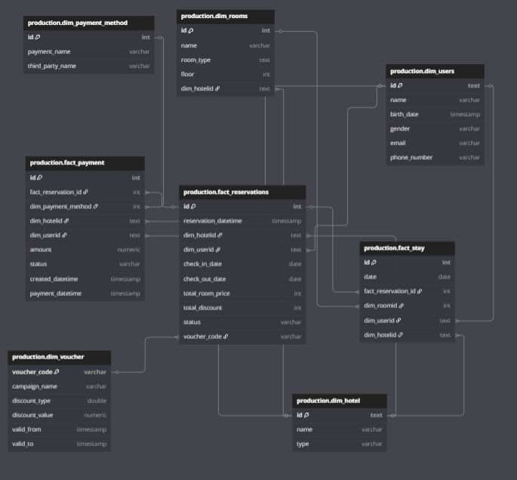
Dimension Tables:
dim_users: Stores user profile details such as name, birth date, gender, email, and phone number.
dim_rooms: Contains room metadata including room name, type, floor, and associated hotel.
dim_hotel: Describes hotels by name and type.
dim_payment_method: Lists available payment methods and associated third-party names.
dim_voucher: Holds information on promotional campaigns, discount types and values, and validity periods.
Fact Tables:
fact_reservations: Captures reservation events, including check-in/out dates, total price, discounts, and status. Links to users, hotels, and vouchers.
fact_payment: Records payment transactions linked to reservations, with details on amount, method, and timestamps.
fact_stay: Tracks actual user stays, linking back to reservations, users, hotels, and room details.

Slide 15
Purpose & Benefit:
This model enables robust reporting and analytics by separating static descriptive data (dimensions) from dynamic transaction data (facts). It supports use cases for:
Reservation and occupancy analysis
Revenue tracking
Campaign effectiveness
User behavior insights
This design is scalable and ready to be transformed into dedicated data marts for different departments like Finance, Marketing, or Management (BOD).

Slide 16
To manage data access securely, we create user roles/groups and assign them permissions based on their department needs.
For example:
The data_team role is granted full access (read/write) to all schemas (raw_data, analytics, production).
The finance_team role is granted read-only access to the mart_finance schema only.
Then, we assign users (e.g., Adam to data_team, Ranti to finance_team) to their respective roles. This approach ensures proper data governance, access control, and security, while allowing teams to work independently with the data they need.
Click here for Detail Query..

Slide 17
Future Improvement: Manual Mapping with NocoDB
In the future, i will plan to introduce NocoDB as a lightweight no-code tool to handle manual mapping tasks. This will be useful especially for dealing with data anomalies or cases where automated transformation cannot fully resolve inconsistencies.
I will create a dedicated schema_mapping schema to store mapping reference tables that can be maintained directly via NocoDB by the business or data team. For example:
Mapping of inconsistent payment methods or voucher names
Standardizing user-entered values across systems
Handling legacy or external reference data
This improvement allows more flexibility, enables non-technical users to contribute directly to data quality, and ensures better accuracy for downstream reporting and analytics.

Slide 18
THANK YOU!

